Slide 1
Analyzing Food Prices
Prasanna Muppidi Yamini Sai Kota MouniSri Muppidi

Slide 2
Data Cleaning and Transformations
The first step is to combine all food types data into one and fill the null values with the preceding values.
After that, we need to calculate the average yearly price for every item.
We can obtain the Consumer Price Index (CPI) for each year from data.bls.gov.cpi.
Next, we'll create new columns for every item to calculate the change in average cost percentage by years.
Additionally, we'll create new columns for the average prices within each category.

Slide 3
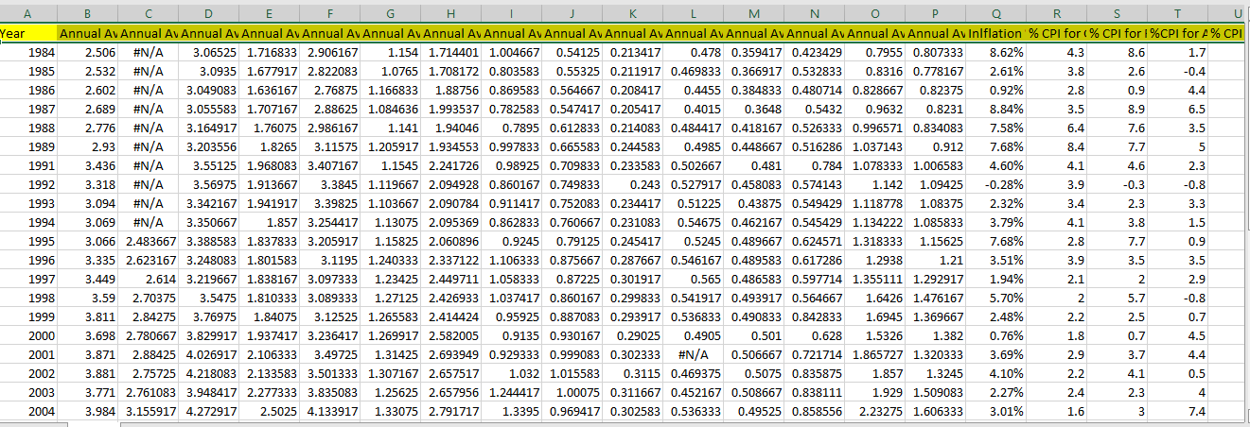
Calculating avg yearly price for every item

Slide 4
Question 1
Patterns of price trend for fruits, animal products, grains and dairy products

Slide 5
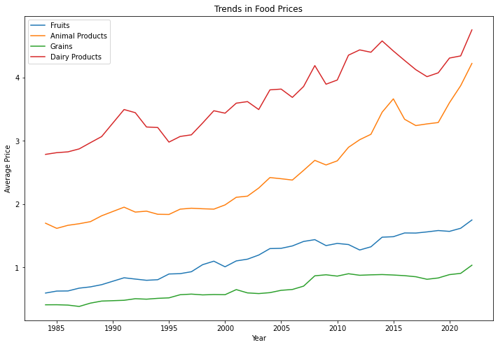
Question 1:-Patterns of price trend for fruits, animal products, grains and dairy products

Slide 6
Are the trends statistically different
Null Hypothesis: There is no significant difference in the price trends for the food categories
Alternate Hypothesis: The price trends for the food categories are statistically significantly different.
From above, we can conclude trend are statistically different as p < 0.05 (level of significance - 5%)

Slide 7
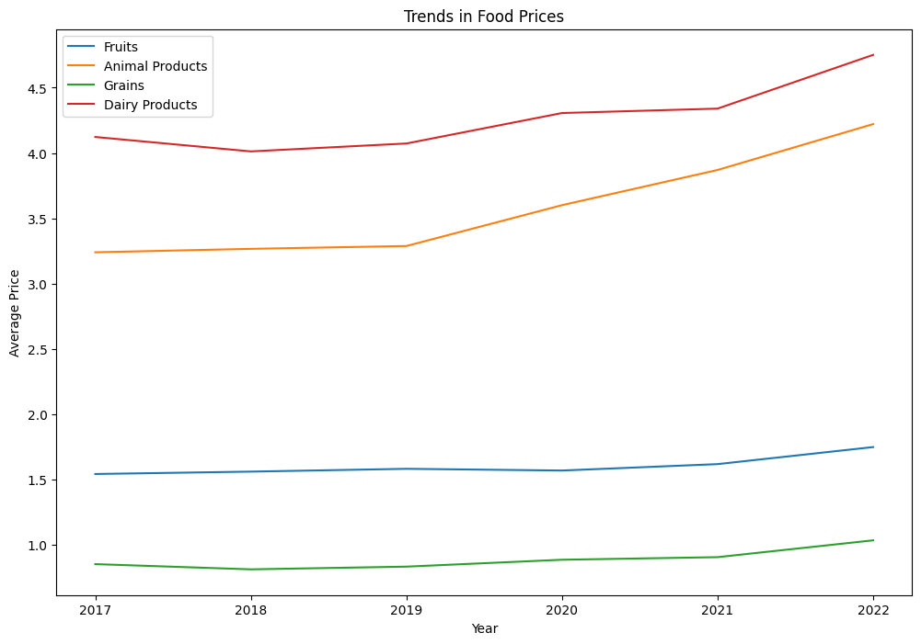
Patterns of price trend for fruits, animal products, grains and dairy products for last 5 years

Slide 8
Question 2
Are the trends within Food Categories same or different

Slide 9
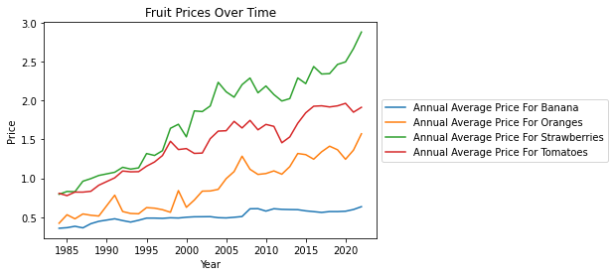
Patterns in Within Food Category Fruits

Slide 10
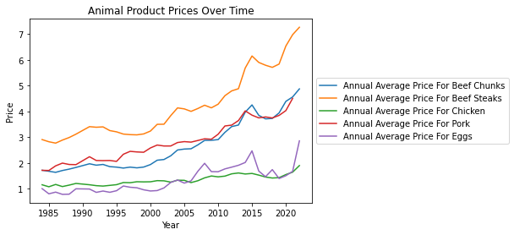
Patterns in WithIn Food Animal Products

Slide 11
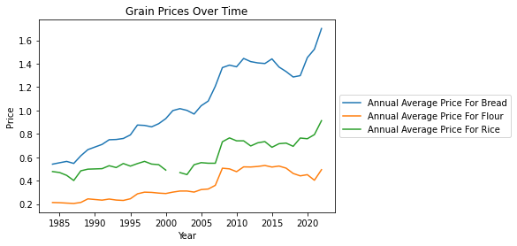
Patterns in WithIn Food Category Grains

Slide 12
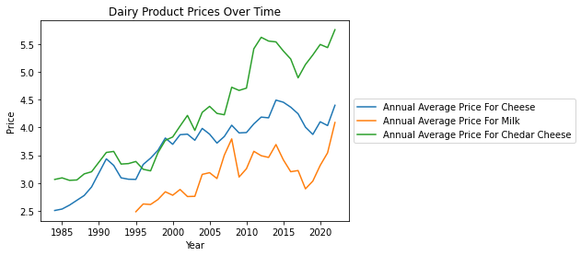
Patterns in WithIn Food Category Dairy Products

Slide 13
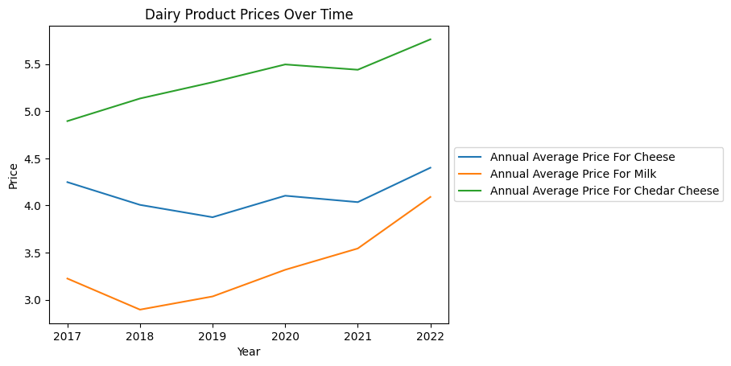

Slide 14
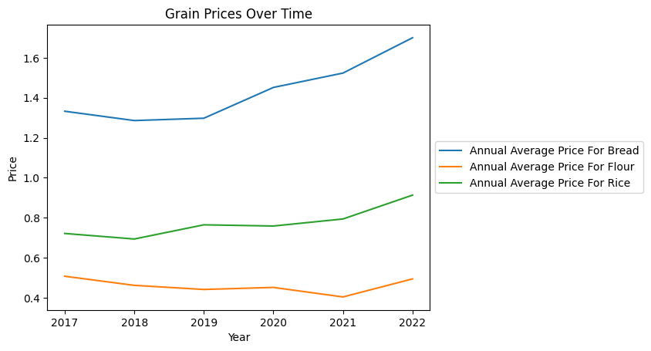

Slide 15
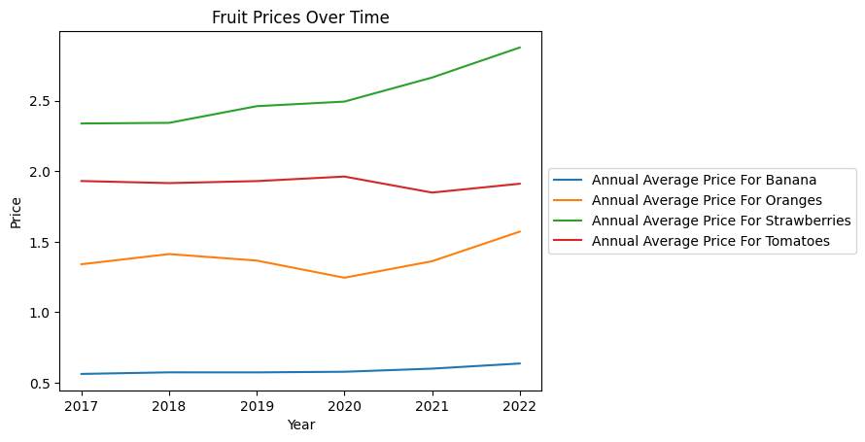

Slide 16
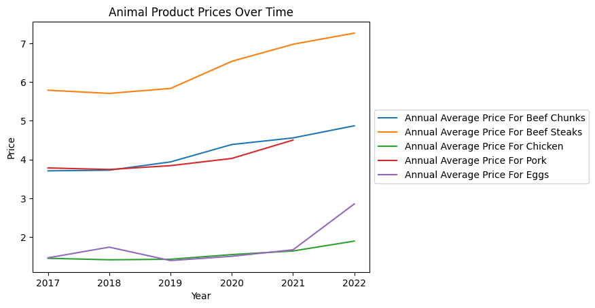

Slide 17
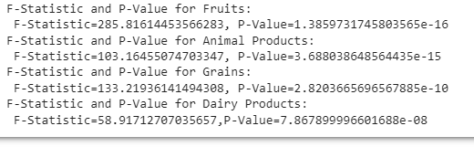
Are patterns in with in food categories are statistically different?
we see that all four food categories (fruits, animal products, grains, and dairy products) have statistically significant differences in their annual average prices. The p-values are all very small, indicating that the probability of obtaining such large differences by chance is very low.
Therefore, we can conclude that there are significant differences in the annual average prices between the different food categories

Slide 18

Question 3 :
Trends before and after Pandemic in Food Prices

Slide 19
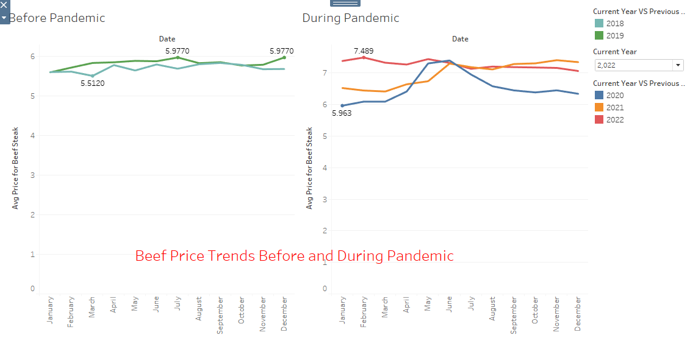
Trend for Beef Prices before and during Pandemic

Slide 20
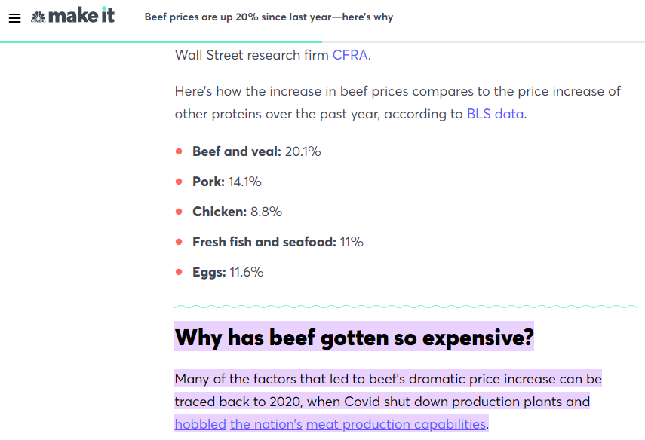
Reasons for increase in beef prices

Slide 21
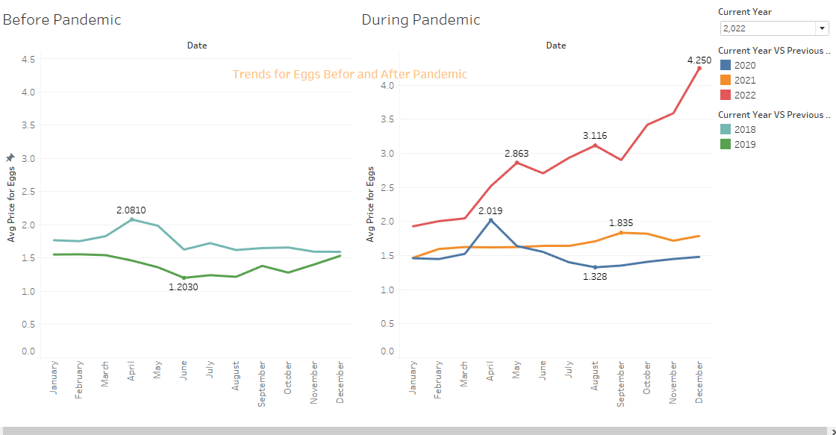
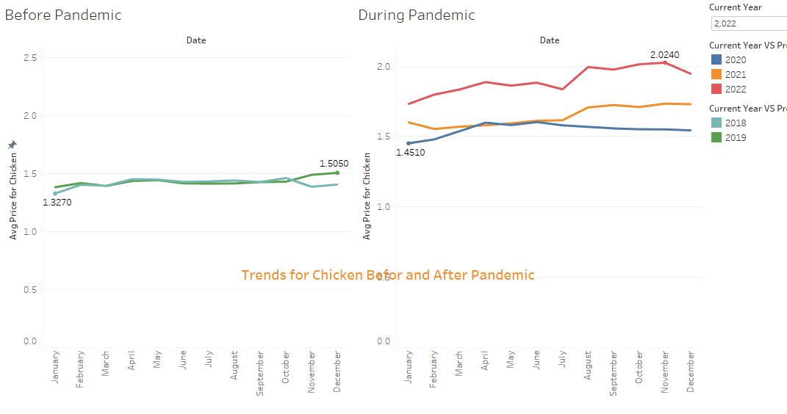
Trend for Eggs Prices before and during Pandemic

Slide 22
Trend for Chicken Prices before and during Pandemic

Slide 23
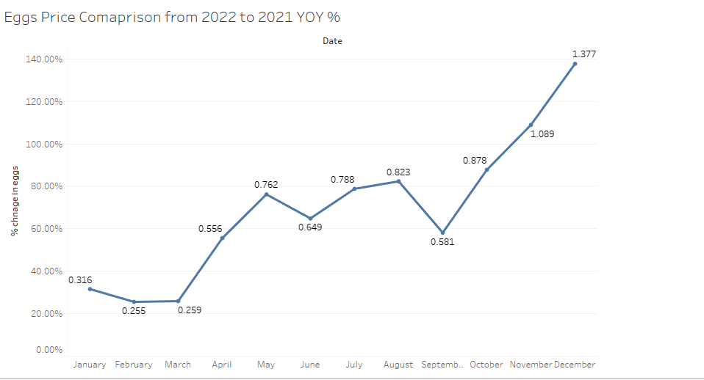
Eggs Price comparison YOY 2022 to 2021

Slide 24
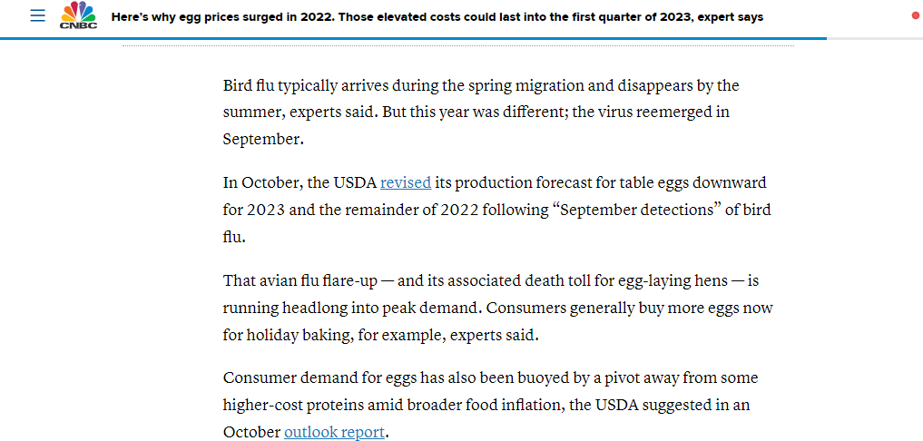
Reasons for rise in eggs prices in 2022

Slide 25
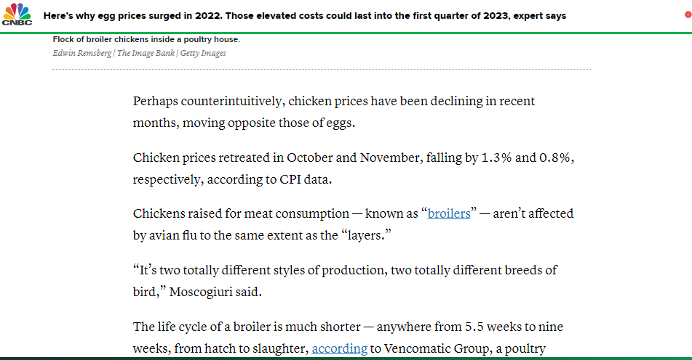
Reasons why egg prices rose in 2022 but not chicken prices

Slide 26
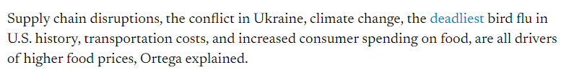
Reasons for increase in food prices in 2022

Slide 27
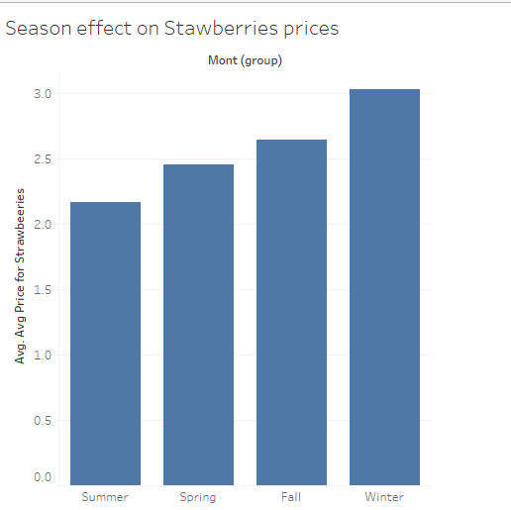

Slide 28
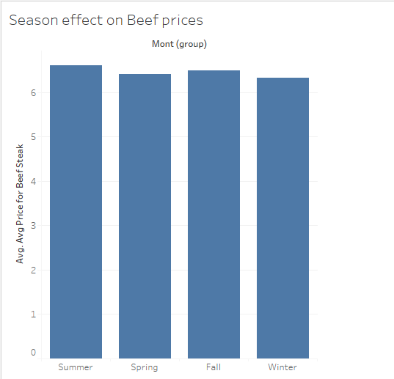

Slide 29
Question 4
Correlation between Inflation and each food type

Slide 30
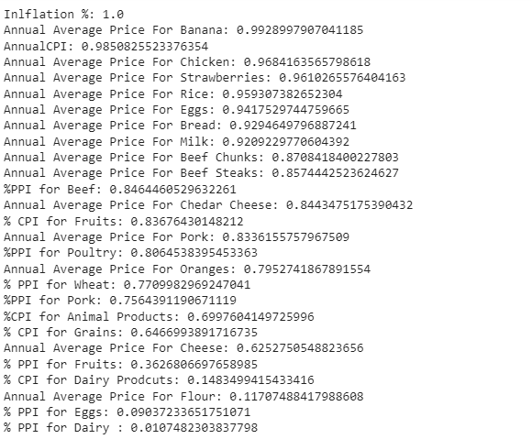
Correlation between Inflation and each type of food

Slide 31
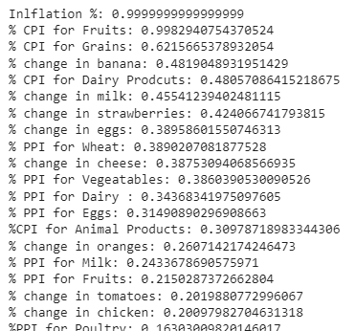
Correlation between Inflation % CPI and % PPI for foods for all years

Slide 32
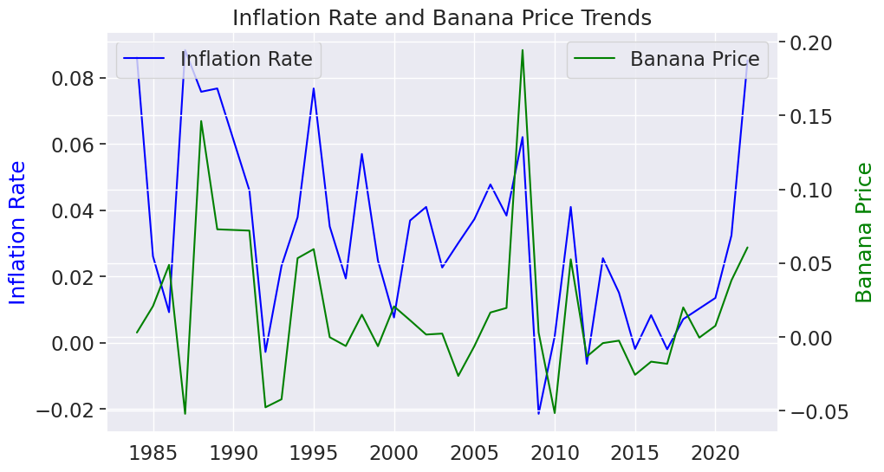
Inflation and % change in Banana prices

Slide 33
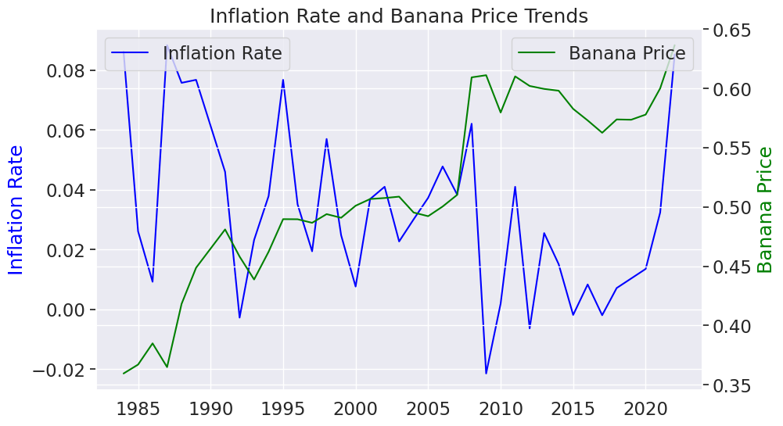
Inflation and Banana prices

Slide 34
Question 5
Correlation between CPI , PPI and Food Price Change

Slide 35
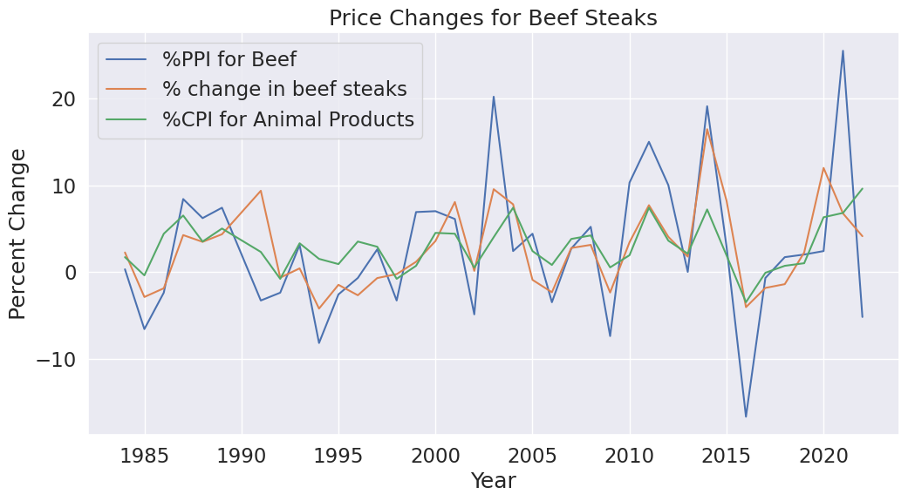

Slide 36
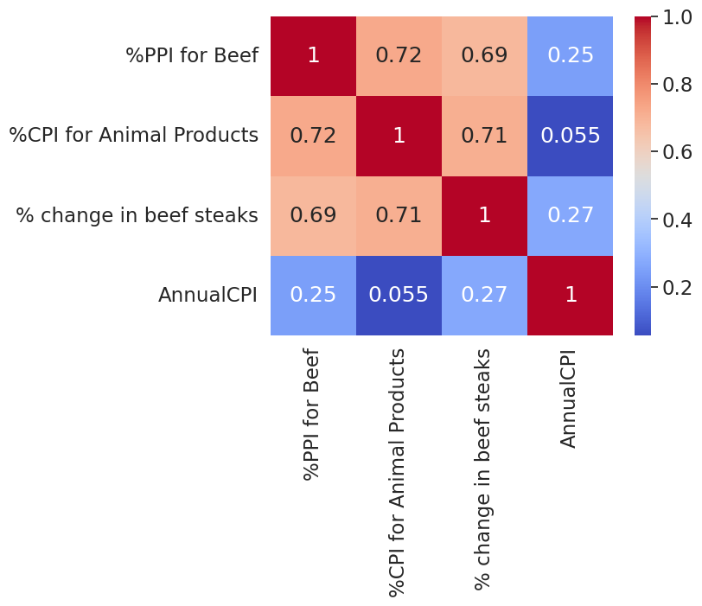
Correlation between CPI , PPI and food price changes in Beef

Slide 37

Question 6
Predicting Food Prices

Slide 38

Predicting change in beef prices
XGBOOST for predicting increase in beef prices
When we predicted for beef, we see 5% change for 2023

Slide 39

RandomForestRegressor
XGBOOST for predicting increase in beef prices
When we predicted for beef, we see 5% change for 2023

Slide 40

Predicting change in Milk and Oranges
When we predicted for milk, we see 7% change for 2023, fruits 3%

Slide 41

Predicting change in Wheat
XGBOOST for predicting increase in wheat prices
When we predicted for wheat, we see 11% change for 2023

Slide 42
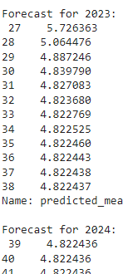
Forecast for % change in Beef using ARIMA

Slide 43
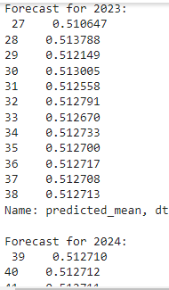
Average prices for Flour in 2023 and 2024 using ARIMA

Slide 44

THANK YOU

